Slide 1


G R EEN K EYG LO BAL. C O M

Slide 2
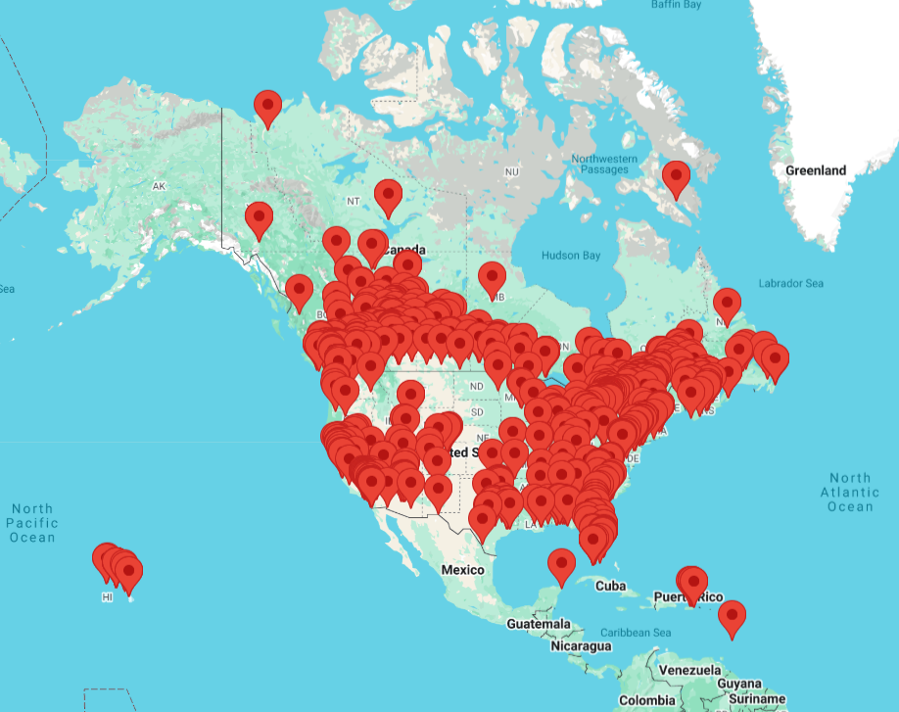

OVER 30 YEARS OF SUSTAINABILITY LEADERSHIP
G R E E N K E Y G L O B A L
Est. in 1994 by Hotels Canada (formerly the Hotel Association of Canada)
Green Key Global
is a credible, leading sustainability certification for hotels and event spaces in
North America
The only certification created by Hoteliers specifically for Hoteliers
Green Key Global plants a tree for every member with our charity partner, One Tree Planted

Slide 3






A Powerful Partnership
“A seamless certification solution for North America.”
Green Key Global is the leading Hotel Sustainability Program in USA & Canada

Slide 4






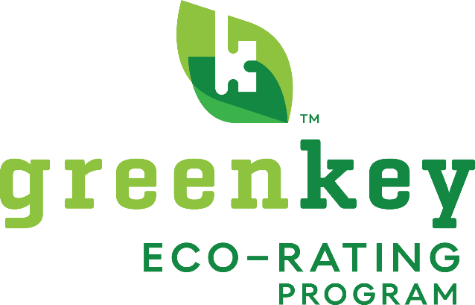
















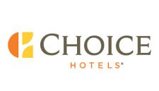
THE ECO-RATING PROGRAM
Endorsed by leading brands through multi-year partnerships
An industry-recognized sustainability certification for hotels and resorts
1100+
Best Western properties in the program
550+
Marriott properties in the program
250+
Choice properties in the program

Slide 5
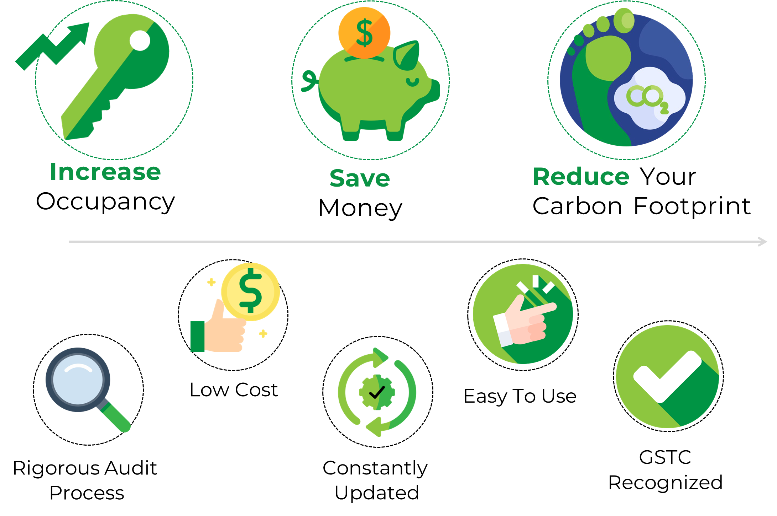
Benefits
G R E E N K E Y G L O B A L
Globally Recognized Certification

Slide 6



T R A V E L E R S A R E S U S T A I N A B L Y S E A R C H I N G
Booking Engines Are Adapting
Certified properties
FEATURED HERE

Slide 7

How It Works

Slide 8


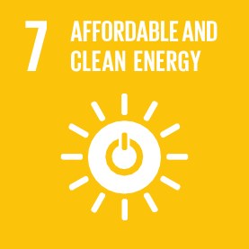



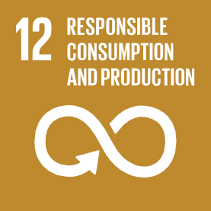







G R E E N K E Y G L O B A L C R I T E R I A
Aligned With United Nation’s SDG’s
Green Key Global is aligned with all 17 of the United Nations Sustainable Development Goals
These goals are the underpinning of sustainability
This means properties certified through Green Key Global are also in alignment with all 17 SDGs!

Slide 9










GR EEN K EY GL O B AL
K E Y P E R F O R M A N C E A R E A S :
CORPORATE ENVIRONMENTAL MANAGEMENT
HOUSEKEEPING
FOOD & BEVERAGE OPERATIONS *
CONFERENCE & MEETING FACILITIES *
ENGINEERING
Form a green team to answer questions & move forward with daily sustainability tasks and set science-based targets!
* Optional for limited-service properties

Slide 10














5 Green Keys
80%-100%
A hotel that exemplifies the
highest standards of
environmental and social
responsibility throughout all
areas of operations.
AWARDING YO UR
4 Green Keys
60%-79.9%
Based on the results of a comprehensive environmental self- assessment, lodging facilities are awarded a rating from 1 to 5 Keys (5 Keys being the highest attainable).
3 Green Keys
40%-59.9%
2 Green Keys 20%-39.9%
1 Green Key
1%-19%
A hotel that has taken first
steps to reduce environmental impacts by analyzing its operations and identifying opportunities for improvement.

Slide 11
CORE CRITERIA
Mandatory Questions
CLARITY ON BASELINE REQUIREMENTS FOR CERTIFICATION
The core criteria are baseline operational processes & practices required to achieve a 1 Green Key Eco-Rating Certification (37 questions). Areas include Corporate, Housekeeping, and Engineering.
TANGIBLE SUPPORT TOOLS TO ASSIST IN MEETING REQUIREMENTS
The questions that make up the core criteria are accompanied by supporting templates and guidance, and where relevant, documentation from brands.
IMPROVED EXPERIENCE TO REDUCE BURDEN ON RESOURCES
Members may proceed directly to the audit phase once the core criteria requirements (questions + supporting documents) have been met and submitted.

Slide 12


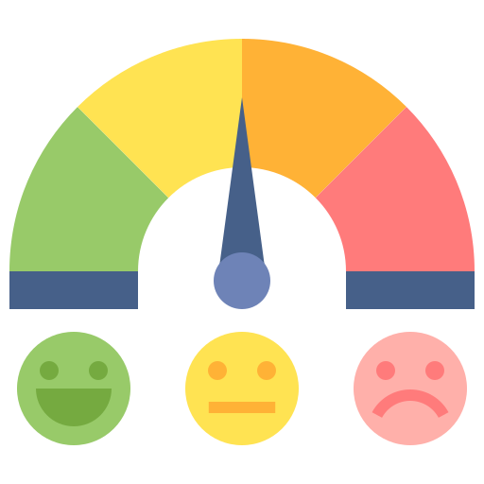





G R E E N K E Y G L O B A L
CERTIFICATION PROCESS
Register Online
www.greenkeyglobal.com
Preliminary System Evaluation
Official Eco Rating
Certification
1 – 5 Key Levels
Receive a Score Improvement Report
Performance Report &
Sustainability Map
Assessment
Audit
Facilitated By Control Union
Specific expertise in sustainability and certification audits
Accredited audit facilitator
Market Your Achievements
Corp. Environmental Mgmt.
Housekeeping
Property & Brand level opportunities
Marketing Toolkit available!
Food & Beverage Operations
Conference & Meeting Facilities
Engineering

Slide 13
Process Walkthrough

Slide 14
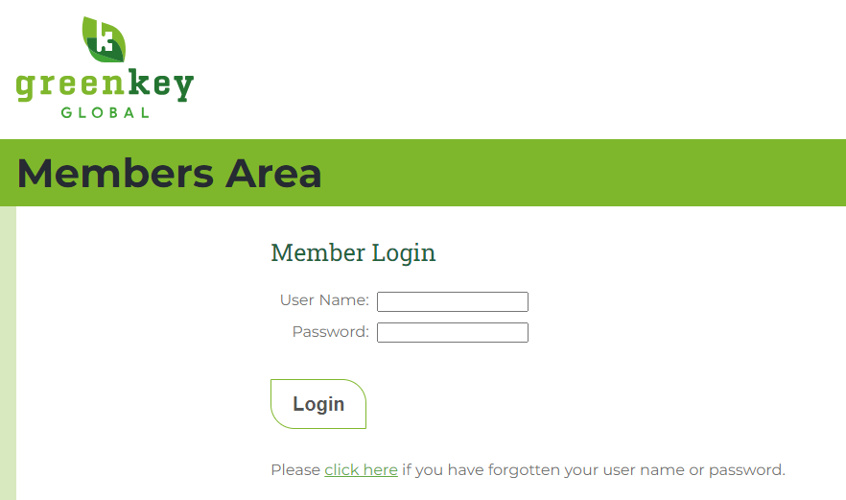

www.greenkeyglobal.com/members
STEP 1

Slide 15
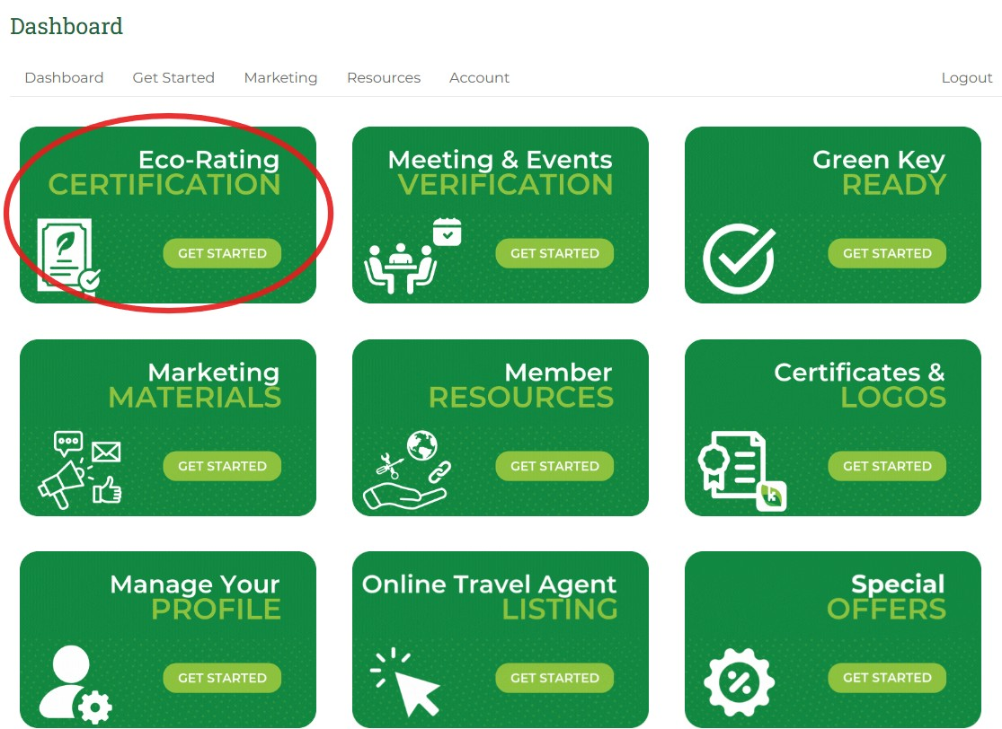
STEP 2

Slide 16
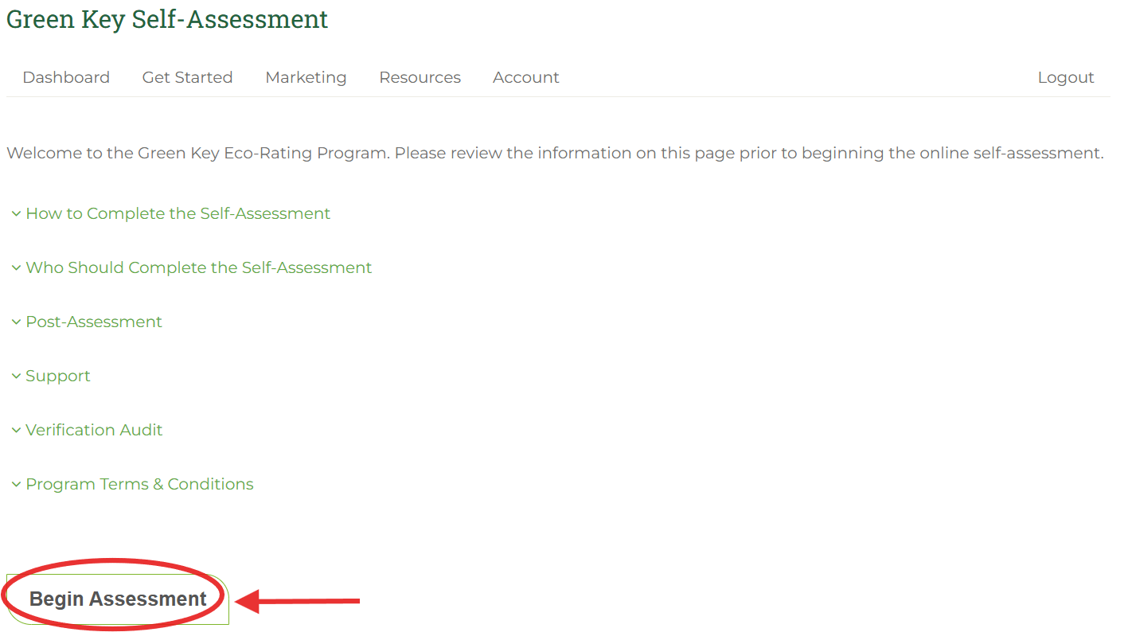
STEP 3

Slide 17
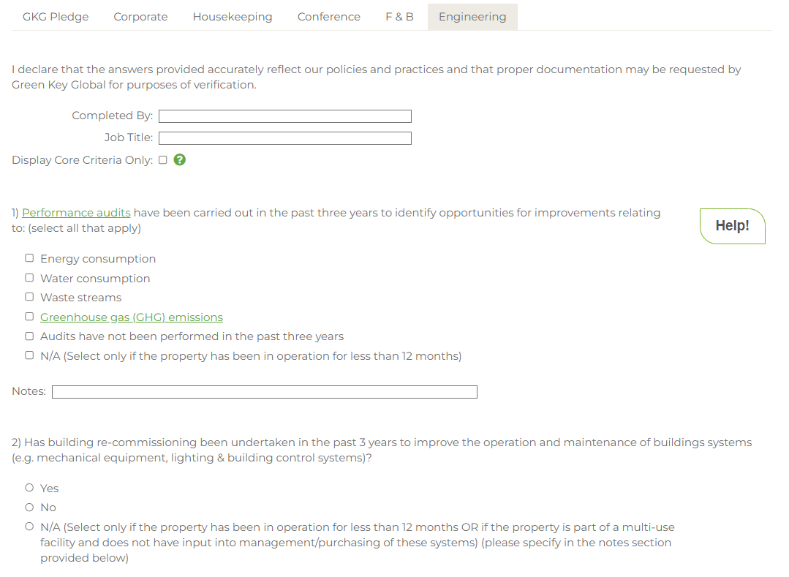
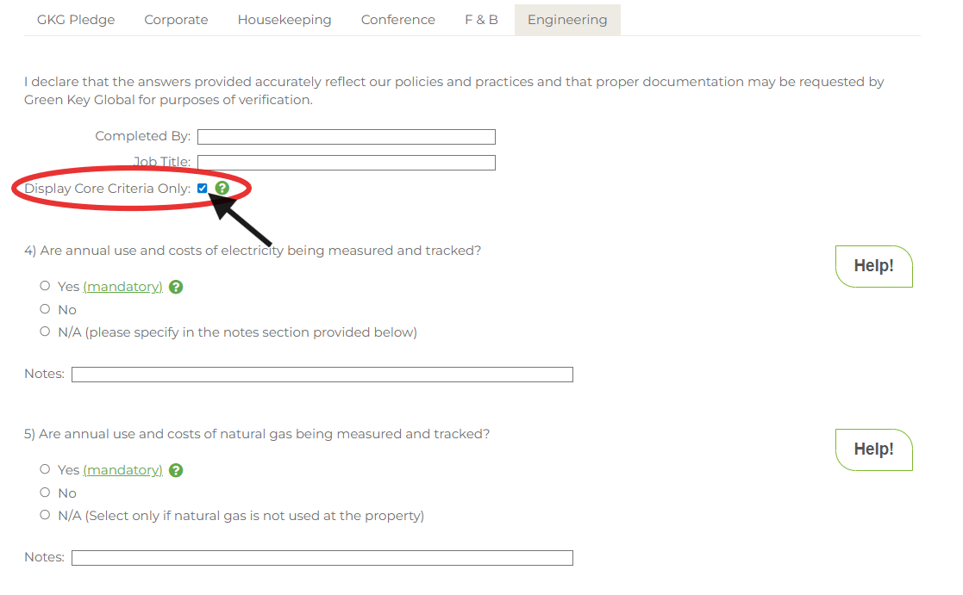
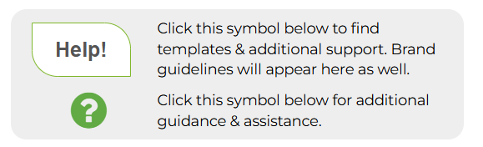

STEP 4
Core Criteria (mandatory questions)
All Questions

Slide 18
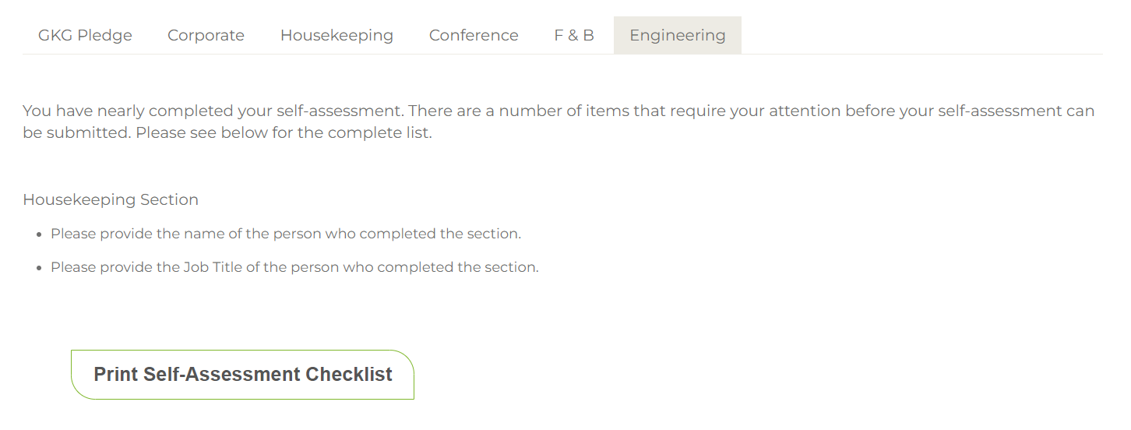
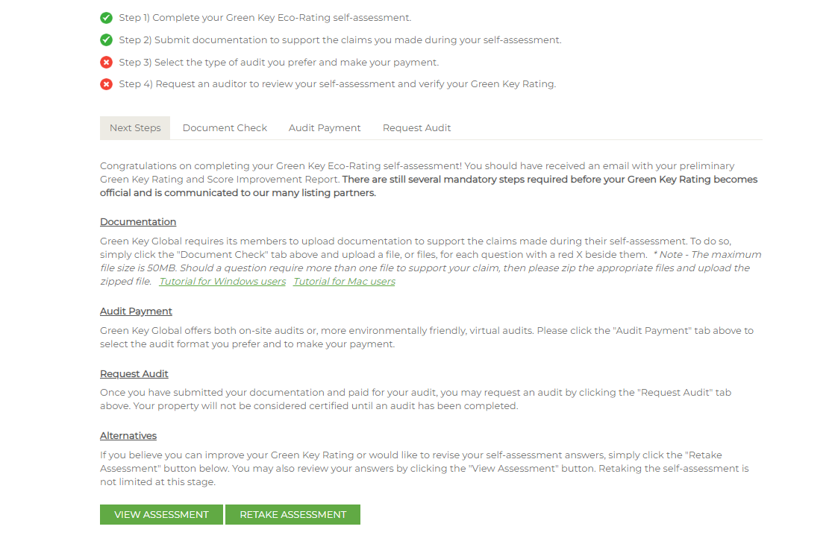

STEP 5

Slide 19
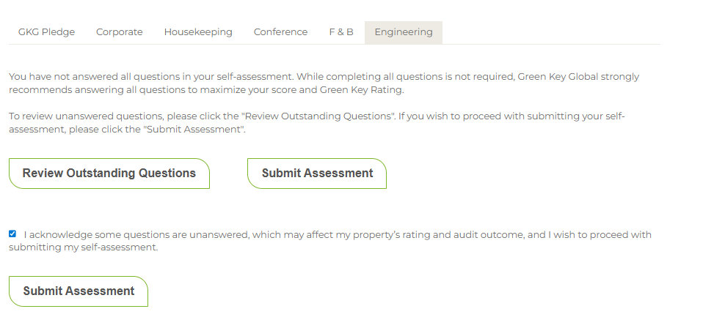
STEP 5b
*If only Core Criteria submitted

Slide 20
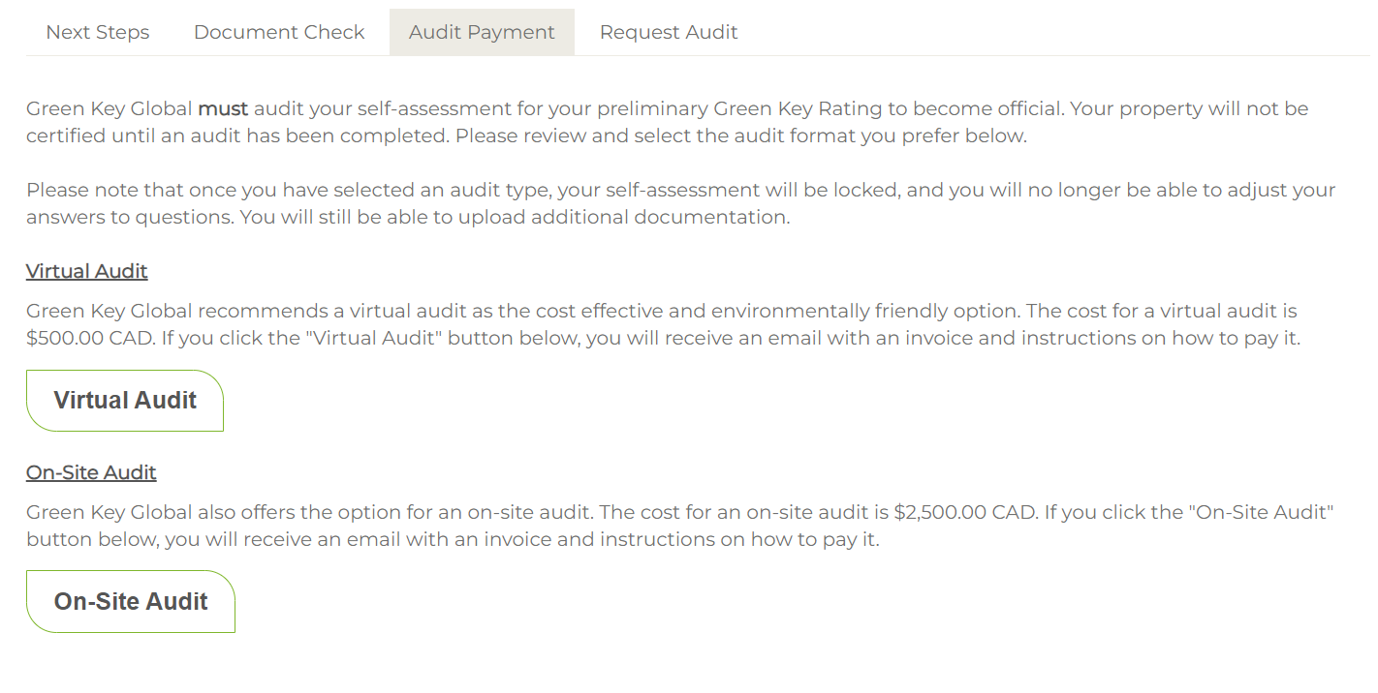
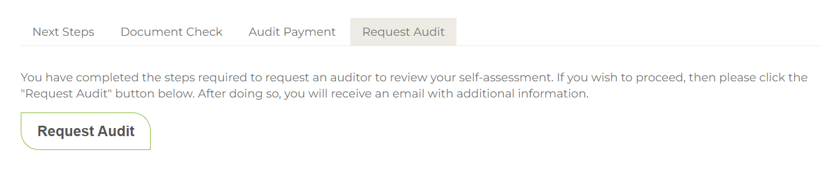
STEPS 6&7

Slide 21
Question Time

Slide 22

ECO RATING FAQs
How long does certification take?
Most properties obtain their Eco-Rating Certification within 90 to 120 days.
The entire self-assessment typically takes 30 days to complete, representing 15-20 hours of effort, including answering questions and uploading supporting documents.
Core Criteria can take as little as 3-4 hours to answer and upload supporting documents.
Once your audit is requested, it generally takes 60-90 days to schedule and complete the audit.

Slide 23
ECO RATING FAQs
How often must I complete a self-assessment and audit?
Your Eco-Rating Certification is valid for 3 years from the date of certification.
Properties must update their certification every 3 years to remain current.
Continued membership in the Eco-Rating program is required to maintain certification status.

Slide 24
ECO RATING FAQs
Will I need to upload a lot of policies and documents?
Depending on your responses, you may need to upload several documents to support your answers.
We’ve included embedded tools, templates, and guidance throughout the self-assessment to make this easier.
Many of our MSA brand partners also provide brand-specific resources, making the documentation process more straightforward for branded properties.
Templates & guidance can be found by clicking the “Help!” icon.

Slide 25
Get in touch!
E-mail
info@greenkeyglobal.com
Website
Phone Address
www.greenkeyglobal.com
1 (226) 895-2630
130 Albert Street, Suite 1206 Ottawa, ON | K1P 5G4

